Slide 1
DDBMS
Chapter 1 - Introduction

Slide 2
Distributed Database
What is Distributed?
Distributed means something is spread across multiple locations or systems, but works together as one.
Example:
Imagine a company has offices in New York, London, and Tokyo. If they share tasks among these offices to work together on a single project, the work is distributed.
What is a Database?
A Database is an organized collection of data stored electronically, which can be accessed, managed, and updated efficiently.

Slide 3
Distributed Database
What is a Distributed Database?
A Distributed Database is a database that is stored across multiple computers (nodes), which may be located in different physical locations, but appear as one single database to users.
Key Points:
Data is split or copied across locations.
Users don't need to know where the data is stored.
The system takes care of fetching data from the correct node.
Example:
Imagine an E-commerce company:
Customers from Asia are stored in a database in Singapore.
Customers from Europe are stored in Germany.
Customers from US are stored in New York.
Still, when a global admin queries for all customers, the system retrieves data from all 3 places and returns it as one result.

Slide 4
DDBMS
A Distributed Database Management System (DDBMS) is software that manages a database distributed across multiple physical locations. These databases may reside on the same network, cloud infrastructure, or multiple geographical locations.
Despite physical distribution, a DDBMS ensures the database appears to users as a single unified system. It handles data fragmentation, replication, location transparency, and concurrency control.
Responsibilities of DDBMS:
Hide the complexity of multiple databases from users.
Provide transparency (location, replication, etc.).
Handle data fragmentation and replication.
Manage network communication between nodes.
Ensure consistency, security, and fault tolerance.

Slide 5
DDBMS
DDBMS divides a logical database into multiple parts (called fragments), which are stored in different locations.
Key Concepts:
Fragmentation: Splitting data into parts (horizontal/vertical).
Replication: Copying data across sites for fault tolerance.
Transparency: Hides distribution from users (location, fragmentation, replication transparency).
Distributed Query Processing: Breaks queries into subqueries, executes at relevant sites, and combines results.

Slide 6
DDBMS
💡 Example Scenario
A bank operates in:
New York (Database A)
London (Database B)
Mumbai (Database C)
How DDBMS works:
User in India wants to check their account → DDBMS fetches data from Mumbai DB.
Head office wants a full report → DDBMS combines data from all 3 locations.
If Mumbai server fails, DDBMS fetches a replicated copy from New York or London.

Slide 7
DDBMS
A Distributed Database Management System (DDBMS) is a software system that manages a single logical database that is distributed across multiple physical locations. These locations could be within the same network or spread over different geographical areas. The DDBMS ensures that the distribution is transparent to users and applications, offering centralized access as if the data is in one place.
Key Features:
Data is stored across multiple sites/nodes.
Offers transparency (location, replication, fragmentation).
Supports concurrent access, reliability, and fault tolerance.
Can support heterogeneous databases and hardware systems.

Slide 8
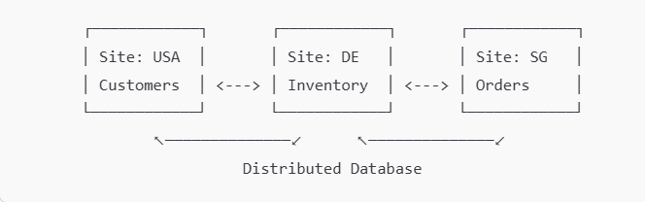
Data is Stored Across Multiple Sites/Nodes
Data in a DDBMS is not stored in a single central location. Instead, it is distributed across multiple physical or logical locations, also called nodes or sites. These nodes can be in the same building, city, or different countries.
➤ Example:
An international e-commerce company stores:
Customer data in the US,
Product inventory in Germany,
Order history in Singapore.
Each site can manage its own portion of the data but they all operate as one unified system.

Slide 9
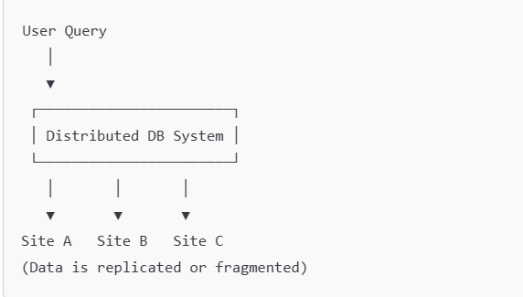
Transparency (Location, Replication, Fragmentation)
Transparency means that the user does not need to know:
Where the data is located (Location Transparency)
How many copies of data exist (Replication Transparency)
Whether data is split into fragments (Fragmentation Transparency)
The system handles all complexities behind the scenes.
Example:
A user queries customer data using SELECT * FROM Customers; Even if that data is fragmented or replicated across multiple countries, the user sees it as if it’s coming from a single local database.

Slide 10
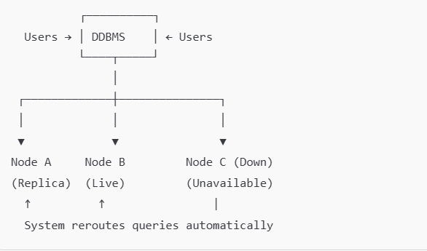
Supports Concurrent Access, Reliability, and Fault Tolerance
➤ Explanation:
Concurrent Access: Multiple users from different locations can access the database at the same time without interference.
Reliability: The system continues to function properly even if some sites fail.
Fault Tolerance: If one site crashes, the others can take over without data loss or system failure.
➤ Example:
If one database node in Tokyo goes down during a natural disaster, the replicated data in Sydney can serve the same queries without downtime.

Slide 11
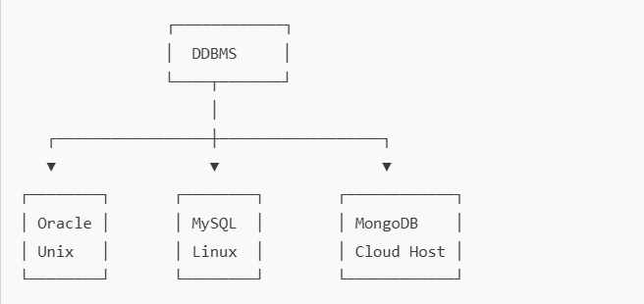
Can Support Heterogeneous Databases and Hardware Systems
A DDBMS can manage data stored in different database systems (e.g., Oracle, MySQL, SQL Server) and different hardware platforms (e.g., Linux, Windows, cloud, on-premise).
➤ Example:
A financial company uses:
Oracle on Unix for transactions,
SQL Server on Windows for reporting,
MongoDB on the cloud for real-time analytics.
All are connected through a DDBMS interface to provide a seamless experience.

Slide 12
Summary
Feature | Description | Example
Data across sites | DB is split across locations | E-commerce with global data
Transparency | Hides fragmentation, replication, and location from users | Query from one place, data is everywhere
Concurrent Access & Fault Tolerance | Many users + system stays up if one part fails | Backup nodes handle failures
Heterogeneous Support | Different DBMS and hardware work together | Oracle + SQL Server + MongoDB integration

Slide 13
Problems in Distributed DBMS
Problem | Description
Data Consistency | Maintaining consistency across replicas is complex.
Network Dependency | Performance relies heavily on network quality.
Complex Transactions | Distributed ACID transactions are harder to manage.
Synchronization | Managing concurrent updates across sites.
Security | Harder to enforce consistent security policies across all locations

Slide 14
Real-Life Example: Amazon
Amazon operates globally and must ensure high availability and low latency. They use distributed databases across global data centers.
Example:
Customer in India placing an order.
Product inventory is located in a Singapore region DB.
Payment service may be hosted in a U.S. region.
Final order data is synchronized across distributed services using replication and eventual consistency.

Slide 15
Basic Network Concepts
Concept | Description
Node | A system (server) that stores a part of the distributed database.
Site | Physical location of a node.
Network | Infrastructure that enables communication between nodes.
Message Passing | Communication method where nodes exchange queries and data.
Latency | Time delay between sending and receiving a message.
Bandwidth | Data transfer rate between nodes.
Throughput | Number of queries handled by the system over time.
Fault Tolerance | Ability to maintain operation despite node/network failure.
Distributed databases consist of multiple databases across different networked locations that communicate and coordinate to act as a single system.

Slide 16
Data Transfer and Communication Protocols
Protocol | Use Case
TCP/IP | Reliable, ordered data transmission (e.g., SQL queries).
UDP | Faster, less reliable – rarely used for DB communication.
HTTP/HTTPS | Used in web APIs over distributed databases (e.g., NoSQL REST calls).
gRPC | Efficient binary communication between distributed nodes (common in microservices).

Slide 17
Network Issues and Solutions
Issue | Solution
High Latency | Use data replication or caching.
Packet Loss | Use reliable transport (TCP).
Network Partitioning | Use CAP theorem trade-offs (e.g., eventual consistency).
Security Threats | Use TLS, authentication, firewalls.

Slide 18
Distributed Query Execution over Network
When a query involves multiple sites:
Query is decomposed into sub-queries.
Sub-queries are sent to respective sites.
Each site executes its part.
Results are collected and merged at the client or coordinator node.
Example:
Site A: Students table.
Site B: Departments table.
-- Distributed Join
SELECT S.Name, D.DeptName
FROM Students S JOIN Departments D
ON S.DeptID = D.DeptID;
The DBMS breaks the query and executes parts across the network.
Summary Points
Networks are critical in enabling communication between distributed database nodes.
Efficient protocols and architecture determine performance.
Must handle failures, latency, bandwidth, and ensure data consistency across nodes.

Slide 19
Distributed Design & Architecture
A Distributed Database System (DDBS) consists of multiple databases located at different sites but interconnected via a network, working together as a single logical database.
It includes:
Data Distribution Strategy
Communication Protocols
Transaction Management
Query Processing and Optimization

Slide 20
Architectural Models of DDB
Model | Description
Autonomy | Level of control each site has over its data and system.
Distribution | How data is physically distributed across sites.
Heterogeneity | Use of different DBMS, models, or platforms.
DDB architectures can be classified based on three key characteristics:

Slide 21
Autonomy
Type | Description
Tightly Coupled | Centralized control over data and operations (low autonomy).
Loosely Coupled | Each site can operate independently (high autonomy).
Definition:
Refers to the independence of individual databases or nodes in performing local operations without coordination with other nodes.
Example:
Bank Branches having their local databases that sync with a central database.
Each branch can handle local transactions but may periodically sync for central reporting.
How It Works:
Each node has its own DBMS and administration.
Communication occurs only when necessary (e.g., cross-branch transfers).

Slide 22
Distribution
Type | Description
Fragmentation | Tables are split into pieces (horizontally or vertically).
Replication | Same data is duplicated across nodes for availability.
Allocation | Determines which fragment or replica goes where.
Definition:
Describes how data is physically stored and accessed across multiple locations.
Example:
University System:
Campus A: stores data for students with IDs 1–500.
Campus B: stores data for IDs 501–1000.
How It Works:
A Distributed DBMS keeps metadata about data locations.
When a query is run, it is decomposed and routed to the relevant site(s).
Results are combined and returned to the client.

Slide 23
Heterogeneity
Type | Description
Homogeneous DDB | All nodes use same DBMS and schema.
Heterogeneous DDB | Nodes use different DBMSs or data models.
Definition:
Refers to the differences in data models, query languages, and DBMSs across the distributed system.
Example:
A healthcare system where:
Hospital A uses Oracle,
Hospital B uses MySQL,
Lab uses a NoSQL document DB.
How It Works:
Uses a middleware layer to translate queries across DBMS types.
Provides a unified interface to clients despite underlying diversity.

Slide 24
How All Three Models Interact
In a real-world DDB:
Feature | Example Behavior
Autonomy | Each hospital manages its local database.
Distribution | Data is divided across hospitals by region.
Heterogeneity | One hospital uses PostgreSQL, another uses MongoDB.

Slide 25
Types of Distributed Databases - Based on Homogeneity
Homogeneous Distributed Database: A distributed database system where all physical locations use the same DBMS software and data models.
Example: Oracle Distributed Database using Oracle DBMS across all sites.
Advantage: Easier to manage and integrate due to uniform DBMS across nodes.
Disadvantage: Limited flexibility to incorporate diverse database systems.
When to Use: When consistency, simplified administration, and uniformity are priorities across distributed sites.

Slide 26
📝 Summary Table
Model | Key Point | Real-World Analogy
Autonomy | Sites manage their own operations | Each branch of a company runs locally.
Distribution | Data is spread across locations | Different offices store local documents.
Heterogeneity | Uses different DBMSs | Each office uses different software.

Slide 27
Objectives of DDB Architecture
Transparency (Location, Replication, Fragmentation)
Scalability
Availability
Fault Tolerance
Improved Performance
Data Localization

Slide 28
Transparency
Transparency ensures that users interact with the distributed system as if it's a single system, hiding its complexity.
Location Transparency: Users don’t need to know where the data is stored.
Example: A user queries customer data; they get results without knowing it’s stored in different cities.
Replication Transparency: The system manages multiple copies of data automatically.
Example: A product catalog is copied across servers. When updated in one, it's auto-updated in all.
Fragmentation Transparency: Data is split and stored in parts but appears whole to users.
Example: Employee data is split by department and stored at different sites, but the user queries it as one table.

Slide 29
Scalability Availability Fault Tolerance Improved Performance
The system can grow by adding more nodes without performance loss.
Example: An e-commerce company adds servers to handle increased traffic during sales.
Data is accessible even if some parts of the system fail.
Example: A regional server goes down, but users can still access data from backup servers.
The system continues to operate even during failures.
Example: If a database node crashes, the system reroutes queries to another node with minimal disruption.
Data is stored close to where it’s used, reducing response time.
Example: User data for Europe is stored in a European server, so EU users experience faster access.

Slide 30
Types of DDB Architectures
Client-Server Architecture
Clients request services from servers (DBMS).
Centralized control with multiple distributed access points.
Example: Oracle Net Services.
Peer-to-Peer (P2P) Architecture
Each site (node) can act as both client and server.
Decentralized, no master-slave relationship.
Example: Blockchain systems, Apache Cassandra.
Multi-Database System (MDBS)
Databases are independent but integrated via a common interface.
Useful when databases are owned by different organizations.
Example: Mediator-wrapper architecture.

Slide 31
Types of Data Distribution
🔹 1. Fragmentation
Divides database into smaller pieces (fragments), stored at different sites.
Horizontal Fragmentation – rows (tuples)
Vertical Fragmentation – columns (attributes)
Mixed/Hybrid – combination of both
🔹 2. Replication
Copies of the same data are stored at multiple sites.
Full replication – all data copied everywhere
Partial replication – only some data is copied
Synchronous vs. Asynchronous replication
Example: Master-Slave replication in PostgreSQL or MySQL.
Allocation
Assigns fragments or copies of data to various sites.
Centralized – All data at one site.
Partitioned – Different fragments at different sites.
Replicated and Partitioned – Mix of both.

Slide 32
Design Considerations
Data Distribution Transparency
Query Optimization
Concurrency Control
Deadlock Management
Reliability and Fault Tolerance
Cost of Communication
Security and Compliance

Slide 33
Design Considerations
Data Distribution Transparency
Users should not be aware of how or where the data is distributed.
Example: A banking app shows your account balance even though your profile is stored in one data center, transaction history in another, and branch details elsewhere. The user sees it as one system.
Query Optimization
The system should generate efficient execution plans considering data locations and communication costs.
Example: When joining tables from two different servers, the system chooses to move a small table to where the large table is (instead of vice versa) to reduce data transfer and improve speed.
Concurrency Control
Ensures that simultaneous operations don't interfere with each other and maintain data consistency.
Example: Two users try to update the same bank account balance at the same time. The system locks one transaction until the other finishes to avoid conflicting updates.

Slide 34
Design Considerations
Deadlock Management
Prevents or resolves situations where transactions wait indefinitely for each other to release resources.
Example: Transaction A locks Table X and waits for Table Y; Transaction B locks Table Y and waits for Table X. The system detects this and aborts one to resolve the deadlock.
Reliability and Fault Tolerance
The system must handle failures (hardware/software/network) without losing data or service.
Example: If a server storing order data crashes, the system uses a replicated copy on another server to keep operations running.
Cost of Communication
Minimize the amount of data transmitted over the network to reduce latency and cost.
Example: Instead of sending full customer records across the network, only relevant fields (e.g., name and city) are transmitted during a query.
Security and Compliance
Protect data from unauthorized access and ensure legal/regulatory standards are met.
Example: Healthcare data is encrypted during storage and transfer to meet HIPAA compliance. Access is role-based to protect sensitive information.

Slide 35
Global Directory Issues
A Global Directory (also called a Data Dictionary or Catalog) in a Distributed Database System (DDBS) is a centralized or distributed repository that stores metadata about the structure, location, fragmentation, and replication of the distributed database.
It tells the system:
What data is stored
Where the data is located
How to access it efficiently
Distributed databases store data at different physical locations. The Global Directory plays a crucial role in managing this complexity:
Data Location Management:
Identifies where specific data items are stored across sites.
Avoids redundant searching by pointing queries directly to the correct node.
Query Optimization:
Helps the query processor decide the most efficient access path.
Reduces data transfer and speeds up responses.

Slide 36
Global Directory Issues
Transparency:
Location transparency: Users don’t need to know where the data resides.
Replication transparency: Users don’t need to know how many copies exist or where.
Data Integrity & Consistency:
Ensures that updates, deletions, or additions to data are propagated or referenced correctly.
Scalability:
Facilitates the addition of new nodes or data locations without disrupting the overall system.
Failure Recovery:
Assists in locating replicas and managing failover when a node goes down.

Slide 37
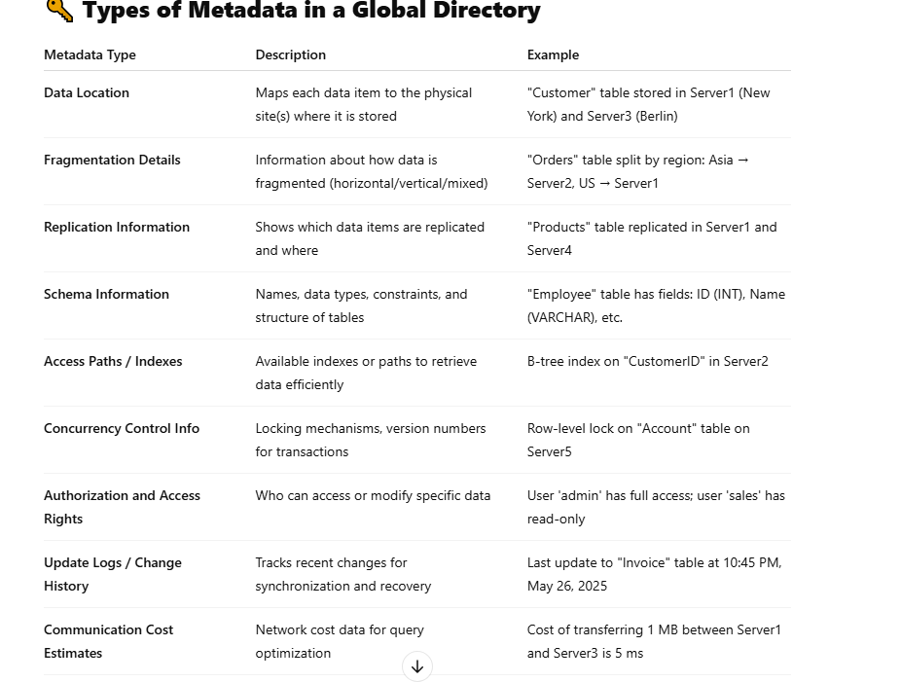
Global Directory Issues

Slide 38
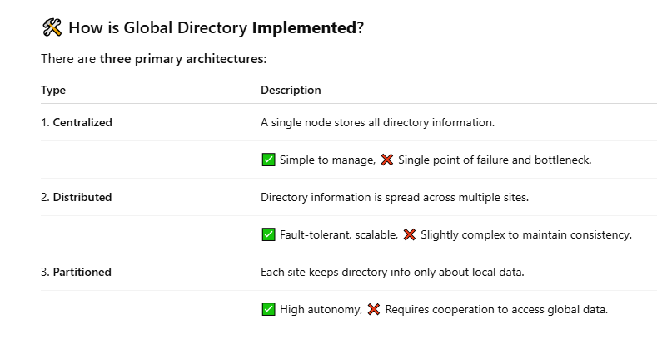

Slide 39
Global Directory Issues
1. Consistency and Synchronization
Keeping multiple copies of the directory synchronized is challenging.
In replicated directories, updates must propagate to all sites.
Example: If a new data fragment is created or moved from Site A to Site B, the update must be reflected across all replicas.
2. Availability
Centralized directories can become a single point of failure.
If the central node goes down, data access is blocked.
Example: In a banking system, if the global catalog server is down, branch offices cannot locate or access customer data stored elsewhere.
3. Scalability
Large systems may find it hard to scale with a centralized directory.
As more data and sites are added, the size and complexity of the directory increases.
Example: An e-commerce platform expanding globally may experience performance degradation if the global catalog grows too large for a central server.

Slide 40
Global Directory Isuses
4. Performance Bottlenecks
Every query might need to consult the directory, increasing latency.
Particularly in centralized setups.
Example: In a logistics company, route optimization queries to different warehouse DBs may lag if all directory lookups go through a central node.
5. Security and Access Control
Directory may expose metadata that can be sensitive.
Requires fine-grained access controls.
Example: An employee might see information about a fragment they shouldn’t access due to role-based restrictions.
6. Update Propagation Delay
In replicated directories, update delays may cause inconsistent views.
Example: A query routed based on outdated directory info might fail or give incorrect results.
Complexity in Query Optimization
Optimizers rely on directory metadata.
Inconsistent or incomplete metadata leads to suboptimal query plans.

Slide 41
SOlution
Issue | Solution
Single point of failure | Use replication and failover
Inconsistent metadata | Atomic update protocols, timestamps
Latency | Use local caching of frequently accessed metadata
Security concerns | Role-based access control (RBAC), encryption
Synchronization overhead | Eventual consistency or distributed consensus
Scalability | Partitioned or sharded directory design

Slide 42
What is Distribution Design?
Distribution design in a Distributed Database System (DDBS) involves how data is partitioned (fragmented), replicated, and allocated across multiple geographically dispersed sites while ensuring performance, consistency, availability, and manageability.
Main Distribution Design Issues
Data Fragmentation
Definition:
Splitting a database into smaller pieces (fragments) which can be stored at different sites.
Types:
Horizontal Fragmentation: Divides rows (tuples)
Vertical Fragmentation: Divides columns (attributes)
Hybrid/Mixed: Combination of both
Issues:
Correctness: Can you reconstruct the original table from the fragments?
Minimizing Redundancy: Avoid unnecessary data duplication
Query Performance: Poorly designed fragmentation can degrade performance

Slide 43
What is Distribution Design?
Data Allocation
Definition: Deciding where each fragment or copy should be stored.
Types:
Centralized: All data at one site
Partitioned: Different sites store different fragments
Replicated: Copies of fragments at multiple sites
Issues:
Data locality vs. access frequency
Storage and network costs
Update cost vs. query speed
Example: In a retail chain:
Branch inventory data is stored locally
Master pricing data is centralized at HQ

Slide 44
What is Distribution Design?
Data Replication
Definition: Storing multiple copies of data at different locations.
Pros:
Increases availability and fault tolerance
Improves read performance
Cons:
Increases update complexity
Requires synchronization
Example: In a global e-commerce platform:
Product catalog is replicated across multiple regions for faster access

Slide 45
What is Distribution Design?
Data Transparency
Design must ensure that users don’t need to know where data is stored.
Types of Transparency:
Location Transparency
Replication Transparency
Fragmentation Transparency
Issue:
Must be handled at the DDBMS level; adds system complexity
Example: A user query like SELECT * FROM Customers should return results regardless of where customer records are stored (India, USA, or Europe).

Slide 46
What is Distribution Design?
Concurrency Control
Ensures consistent results when multiple transactions occur simultaneously at different sites.
Issues:
Distributed deadlock detection
Locking and timestamp mechanisms across nodes
Trade-off between isolation and performance
Example: Two users from different branches trying to update the same account balance simultaneously.

Slide 47
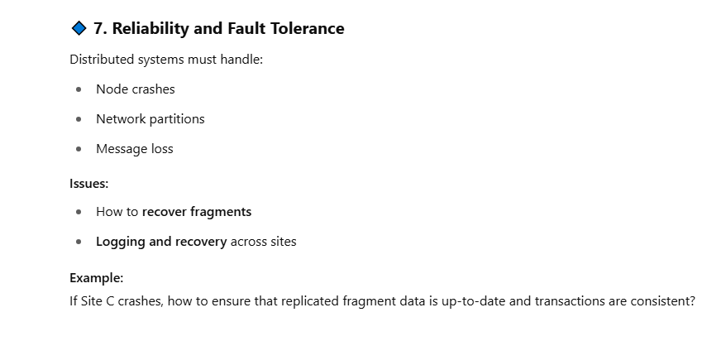
What is Distribution Design?

Slide 48
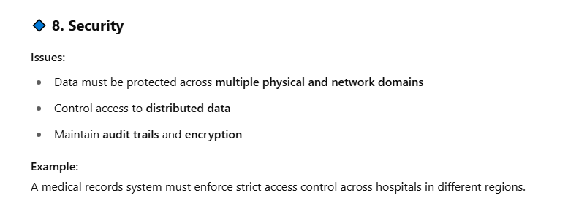
What is Distribution Design?

Slide 49
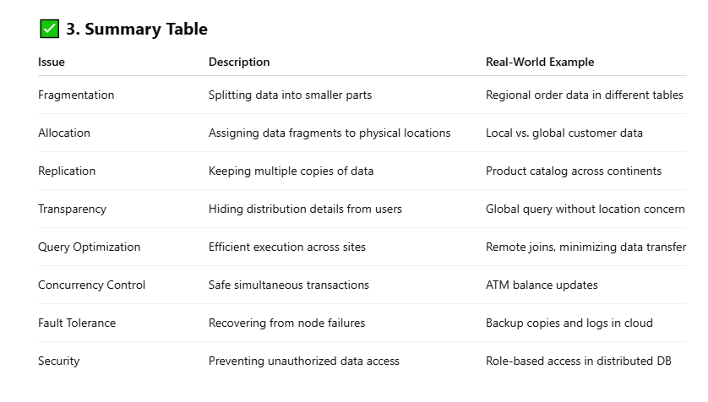

Slide 50
Types of Distributed Databases - Based on Homogeneity
Heterogeneous Distributed Database: A distributed database system where different sites use different DBMS software or data models.
Example: A system combining Oracle, MySQL, and SQL Server databases.
Advantage: Enables integration of diverse databases and legacy systems.
Disadvantage: Complex to manage due to differences in DBMSs and data models.
When to Use: When existing systems with different DBMSs need to be integrated without replacing them.
Example:
A bank using Oracle in HQ, SQL Server in branch offices, and MongoDB for analytics.
A university has different departments using different DBMSs (e.g., Oracle for administration, MySQL for research, and MS SQL Server for library).
-- Middleware (e.g., Apache Drill) to unify queries
SELECT * FROM mongo_branch.customers
UNION
SELECT * FROM oracle_hq.customers;

Slide 51
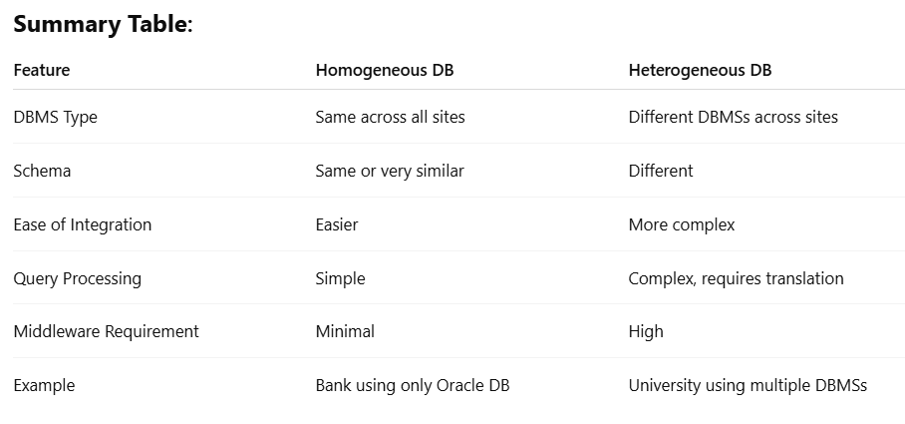

Slide 52
Types of Distributed Databases - Based on Architecture
Client-Server Distributed Database: A database system where the server manages database storage and access, while clients request and use data services over a network.
Example: A web application where the backend server hosts a PostgreSQL database and clients access it via APIs.
How it Works: Clients send requests to the database server, which processes them, performs operations, and returns results to the client.
Advantage: Centralized control with efficient resource sharing and easier maintenance.
Disadvantage: Server can become a performance bottleneck or single point of failure.
When to Use: Ideal for environments requiring centralized data management with multiple client access, such as web or enterprise applications.

Slide 53
Types of Distributed Databases - Based on Architecture
Here are the steps of how a Client-Server Distributed Database works:
Client Initiates Request: A user or application (client) sends a query or request to access, insert, update, or delete data.
Request Sent Over Network: The client’s request is transmitted over the network to the database server.
Server Receives and Interprets Request: The server receives the request, parses the query, and determines the necessary actions.
Data Processing: The server accesses the appropriate database tables, executes the required operations (read/write), and processes the query.
Response Generation: The server generates a response (e.g., result set for a SELECT query or success message for an INSERT).
Response Sent to Client: The processed results are sent back over the network to the requesting client.
Client Displays or Uses Data: The client application receives the response and displays it to the user or uses it for further processing.
Connection Management: The server may keep the connection open for ongoing interactions or close it after the request, depending on the architecture (persistent vs. non-persistent).

Slide 54
Types of Distributed Databases - Based on Architecture
What is Peer-to-Peer Distributed Database: A distributed system where all nodes (peers) are equal and can act as both data providers and requesters without a central server. A system where each node (peer) has equal responsibilities, storing and managing its own data while also collaborating with other peers.
Simple Relevant Example for Students: File-sharing apps like BitTorrent where each user (peer) shares and accesses files directly with others.
How it Works: Each peer stores part of the database, processes its own queries, and synchronizes data with other peers as needed.
Advantage: No single point of failure and better load distribution across nodes.
Disadvantage: Data consistency and synchronization can be difficult to manage.
When to Use: Useful in decentralized environments where continuous availability and fault tolerance are essential, like collaborative platforms or blockchain systems.

Slide 55
Types of Distributed Databases - Based on Architecture
Here are the steps of how a Peer-to-Peer (P2P) Distributed Database works:
Node Initialization: Each peer (node) starts with its own local database and connects to the network of other peers.
Discovery of Peers: The node identifies and establishes connections with other peer nodes in the network.
Data Request Initiation: A peer initiates a query or data request, which may involve local data or data from another peer.
Query Routing: If the data is not found locally, the request is routed to other connected peers that may have the relevant data.
Data Processing: The peer with the requested data processes the query (e.g., retrieves or updates the data).
Data Sharing or Replication (if needed): The responding peer sends the result back, and in some systems, data may be replicated to other peers for redundancy or speed.
Response Delivery: The result of the request is sent back to the original requesting peer.
Synchronization (Optional): Periodically, peers may synchronize data to maintain consistency and update changes across the network.

Slide 56
Types of Distributed Databases - Based on Architecture
What is Multi-Database (MDBS) Distributed Database: An MDBS is a system that integrates multiple autonomous databases, possibly using different DBMSs, into a single framework for access and management.
Simple Relevant Example for Students: A university system where the library uses MySQL, the exam department uses Oracle, and student services use SQL Server, but all are accessed via one interface.
How it Works: Each database remains independent, and a middleware layer coordinates access, translates queries, and integrates results for users.
Advantage: Allows access to diverse, existing databases without modifying their structure or DBMS.
Disadvantage: Complex query processing and data integration due to differences in DBMS and schemas.
When to Use: Ideal when organizations need to unify data access across independently managed and heterogeneous databases.

Slide 57
Types of Distributed Databases - Based on Architecture
Here are the steps of how a Multi-Database System (MDBS) Distributed Database works:
User Query Submission: The user sends a query through a unified interface (middleware) without needing to know which underlying databases will be accessed.
Query Parsing and Analysis: The middleware parses the query and identifies which databases are involved based on schema mapping and metadata.
Query Translation: The query is translated into the appropriate syntax and format for each target database (e.g., MySQL, Oracle, SQL Server).
Subquery Distribution: The middleware sends the respective subqueries to each local database system.
Local Query Execution: Each local database executes its part of the query independently and returns the result to the middleware.
Result Integration: The middleware collects and merges the results from different databases into a single coherent output.
Final Result Delivery: The integrated result is sent back to the user in a unified format, hiding the complexity of the underlying systems.

Slide 58
Types of Distributed Databases - Based on Architecture
What is Cloud-Based Distributed Database: A database hosted on cloud infrastructure, distributed across multiple geographic locations for scalability, availability, and performance.
Simple Relevant Example for Students: Google Docs stores your files in cloud databases like Google Cloud Spanner, accessible from anywhere with internet.
How it Works: Data is automatically distributed across cloud servers; requests are routed to the nearest or least busy server, with the cloud provider handling replication, scaling, and fault tolerance.
Advantage: Highly scalable, reliable, accessible globally, and managed with minimal local infrastructure.
Disadvantage: Dependent on internet connectivity and cloud provider; can be costly over time.
When to Use: Best for applications needing global access, auto-scaling, high availability, and minimal maintenance, like e-commerce or collaboration platforms.

Slide 59
Comparison
Type | DBMS Uniformity | Autonomy | Complexity | Common Use Case
Homogeneous | Yes | Low | Low | Global e-commerce sites
Heterogeneous | No | High | High | Cross-platform banking/enterprise systems
Client-Server | Yes/Partial | Partial | Medium | ERP, University Portals
Peer-to-Peer | Yes | High | Medium | Blockchain, Distributed Ledger Systems
Multidatabase System (MDBS) | No | High | High | Government, Integration across orgs
Cloud-based | Managed | N/A | Low | SaaS, global applications (YouTube, Netflix)
📈 Comparison Table

Slide 60
Types of Distributed Databases - Based on Distribution
What is Fragmented Distributed Database: A database where data is divided into smaller pieces (fragments) and distributed across different locations or sites.
Simple Relevant Example for Students: A university stores student records by campus—each campus database holds only its own students' data.
How it Works: Data is split either horizontally (by rows) or vertically (by columns) and stored at different sites; queries are processed locally or combined from multiple sites as needed.
Advantage: Improves performance and efficiency by storing data closer to where it is used.
Disadvantage: Reconstructing full data or running global queries can be complex and slower.
When to Use: Ideal when different branches or locations frequently access only a subset of the overall data.

Slide 61
Types of Distributed Databases - Based on Distribution
What is Fragmented Distributed Database: A database where data is divided into smaller pieces (fragments) and distributed across different locations or sites.
Simple Relevant Example for Students: A university stores student records by campus—each campus database holds only its own students' data.
How it Works: Data is split either horizontally (by rows) or vertically (by columns) and stored at different sites; queries are processed locally or combined from multiple sites as needed.
Advantage: Improves performance and efficiency by storing data closer to where it is used.
Disadvantage: Reconstructing full data or running global queries can be complex and slower.
When to Use: Ideal when different branches or locations frequently access only a subset of the overall data.

Slide 62
Types of Distributed Databases - Horizontal Fragmentation
Definition: Data is split row-wise—each fragment contains a subset of rows from a table, based on some condition.
Horizontal fragmentation works by dividing a table into multiple subsets of rows based on some condition (like location), helping in performance optimization and data localization in real-world distributed environments.
Example: A university's Students table is fragmented by campus:
Campus A stores: SELECT * FROM Students WHERE Campus = 'A'
Campus B stores: SELECT * FROM Students WHERE Campus = 'B'
Use Case: When different sites need access only to the data relevant to their operations.

Slide 63
Horizontal Fragmentation
✅ Real-World Problem Scenario:
Problem: A university has campuses in New York, Los Angeles, and Chicago. Each campus needs to access only the student records relevant to that campus for faster processing and privacy.
A centralized Students table contains all student records:
Students(StudentID, Name, Email, Campus, Major, GPA)
✂️ Horizontal Fragmentation Solution:
We fragment the Students table horizontally, by campus (i.e., by Campus attribute). Each fragment contains rows (records) of students belonging to a specific campus.

Slide 64
Horizontal Fragmentation
🧩 Fragments:
🗂 Fragment 1: New York Campus
CREATE TABLE Students_NY AS
SELECT * FROM Students WHERE Campus = 'New York';
🗂 Fragment 2: Los Angeles Campus
CREATE TABLE Students_LA AS
SELECT * FROM Students WHERE Campus = 'Los Angeles';
🗂 Fragment 3: Chicago Campus
CREATE TABLE Students_CH AS
SELECT * FROM Students WHERE Campus = 'Chicago';

Slide 65
Horizontal Fragmentation
🔁 Reconstruction Query (if needed):
To get all students from all campuses (i.e., reconstruct original table):
SELECT * FROM Students_NY
UNION ALL
SELECT * FROM Students_LA
UNION ALL
SELECT * FROM Students_CH;
✅ Benefits:
Performance: Each campus queries only its own data.
Security: Campuses can't see students from other campuses.
Efficiency: Less data transfer in distributed networks.

Slide 66
Types of Distributed Databases - Vertical Fragmentation
Definition: Data is split column-wise—each fragment contains a subset of columns (attributes), usually with a common primary key.
Vertical fragmentation divides a table by columns, storing each subset in a different site or system, while retaining the primary key to enable reconstruction. It’s ideal when different departments or applications access different attributes of the same data.
Example: A Students table split into:
Fragment 1 (Academic Info): StudentID, Major, GPA
Fragment 2 (Personal Info): StudentID, Name, Email
Use Case: When different departments or applications need access to different fields of the same table.

Slide 67
Types of Distributed Databases - Vertical Fragmentation
✅ Real-World Problem Scenario:
Problem: A university’s student data is used by two departments:
Academic Department needs access to academic records only.
Administration needs access to contact and personal info only.
A centralized Students table contains all fields:
Students(StudentID, Name, Email, Phone, Major, GPA)
But not all departments need all the columns. Instead of duplicating or querying the entire table, we can split the table vertically.

Slide 68
Vertical Fragmentation
✂️ Vertical Fragmentation Solution:
We divide the table by columns (attributes) based on usage—but always keep the primary key (StudentID) in both fragments to allow reconstruction.
🧩 Fragments:
📘 Fragment 1 – Academic Information:
CREATE TABLE Student_Academic AS
SELECT StudentID, Major, GPA FROM Students;
📇 Fragment 2 – Personal Information:
CREATE TABLE Student_Personal AS
SELECT StudentID, Name, Email, Phone FROM Students;

Slide 69
Types of Distributed Databases - Hybrid Fragmentation
🔁 Reconstruction Query (if needed):
To get the full original data, join the fragments using StudentID:
SELECT *
FROM Student_Academic A
JOIN Student_Personal P ON A.StudentID = P.StudentID;
✅ Benefits:
Security: Departments see only the data they need.
Performance: Less data fetched during queries.
Modularity: Easier to manage and control access.

Slide 70
Types of Distributed Databases - Based on Distribution
Horizontal Fragmentation Example:
-- Asia Site
CREATE TABLE Customers_Asia (
CustomerID INT PRIMARY KEY,
Name VARCHAR(50),
Region VARCHAR(20)
);
-- Europe Site
CREATE TABLE Customers_Europe (
CustomerID INT PRIMARY KEY,
Name VARCHAR(50),
Region VARCHAR(20)
);
-- Customers are stored based on Region
-- Asia DB stores only Region = 'Asia'
-- Europe DB stores only Region = 'Europe'

Slide 71
Types of Distributed Databases - Based on Distribution
Vertical Fragmentation Example:
Site 1 (Customer Identity):
CREATE TABLE Customer_Basic (
CustomerID INT PRIMARY KEY,
Name VARCHAR(50)
);
Site 2 (Customer Contact Info):
CREATE TABLE Customer_Contact (
CustomerID INT PRIMARY KEY,
Email VARCHAR(100),
Phone VARCHAR(20)
);
✅ Advantages:
Reduces query load by storing relevant data locally.
Improves performance for region-specific operations.
❌ Disadvantages:
Complex joins across fragments.
Need for global indexing or metadata management.

Slide 72
Types of Distributed Databases - Based on Distribution - Replication
✅ What is a Replicated Database?
A replicated database is a distributed database system where copies of the same data are stored across multiple servers or locations to ensure availability, fault tolerance, and performance.
📘 Example:
An e-commerce website has users across the globe. The Products table is replicated in servers located in the US, Europe, and Asia to ensure fast and reliable product searches.

Slide 73
Types of Distributed Databases - Based on Distribution - Replication
Suppose you have a Products table in the main server:
CREATE TABLE Products (
ProductID INT PRIMARY KEY,
Name VARCHAR(100),
Price DECIMAL(10, 2),
Stock INT
);
To replicate this data to other servers:
Set up replication configuration (e.g., using MySQL or PostgreSQL replication).
Automatic replication tools (e.g., MySQL binlog, PostgreSQL streaming replication) copy:

Slide 74
Types of Distributed Databases - Based on Distribution - Replication
-- Changes like this on the master
UPDATE Products SET Stock = Stock - 1 WHERE ProductID = 101;
These changes are automatically applied to replica servers.
✅ Advantages:
High availability: Data is accessible even if one server fails.
Faster read performance: Local replicas serve nearby users faster.
Load balancing: Read traffic can be distributed.
❌ Disadvantages:
Complex synchronization: Keeping replicas up to date can be challenging.
Write conflicts (in multi-master setups): Handling concurrent writes is hard.
Storage cost: Requires more space due to data duplication.

Slide 75
Replication
🕒 When to Use:
You need high read performance and global availability.
Your system is read-heavy, like product catalogs or blog content.
You want fault tolerance and disaster recovery

Slide 76
Replication
🧩 Scenario:
You have a distributed system with one primary server (master) and multiple secondary servers (replicas).
The table Users exists in all servers.
🔷 Step 1: Update Occurs on Primary Server
A user updates their profile:
UPDATE Users SET email = 'newmail@example.com' WHERE UserID = 123;
This update is first applied to the primary (master) node.
🔷 Step 2: Change is Logged
The DBMS writes this change to a binary log or transaction log (e.g., binlog in MySQL, WAL in PostgreSQL).
This log entry includes the exact SQL or row-level changes made.
🔷 Step 3: Replication Service Detects Change
A replication agent or replication thread continuously monitors the log file for new changes.
Once it sees the update, it queues the operation for replication.

Slide 77
Replication
🔷 Step 4: Changes Are Sent to Replica Servers
The changes are pushed (or pulled) to the replica nodes over the network.
🔷 Step 5: Replicas Apply the Update
Each replica server reads the log entry and executes the same SQL or applies the row change.
Data is now consistent across all replicas (eventually or immediately depending on sync type).

Slide 78
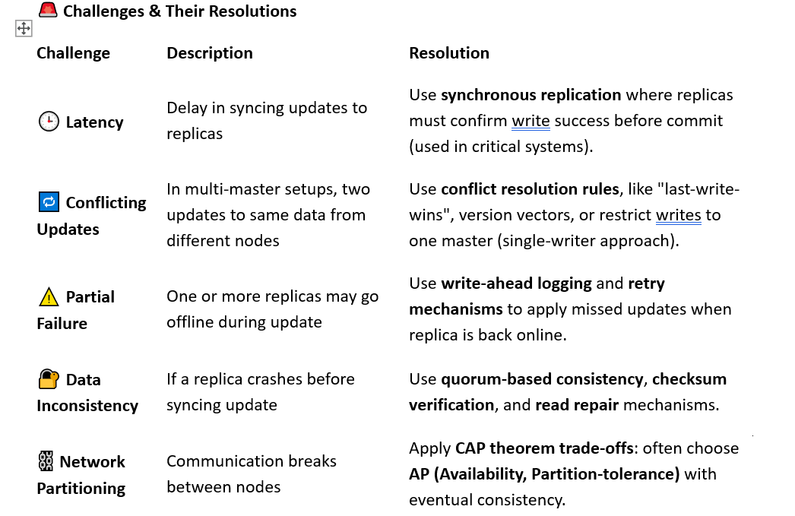
Replication

Slide 79
Types of Distributed Databases - Based on Distribution
Replicated Database
📌 Description:
Same data is copied and stored at multiple sites to provide high availability, redundancy, and fault tolerance.
🔍 Use Case Example:
A global chain like Starbucks replicates inventory and employee tables across all locations.
🧩 Replication Example:
-- Each site has same structure and data
CREATE TABLE ProductInventory (
ProductID INT PRIMARY KEY,
ProductName VARCHAR(50),
Quantity INT
);
-- Data is periodically synced across all locations
-- Site A: Quantity = 100
-- Site B: Quantity = 100 (replicated)

Slide 80
Types of Distributed Databases - Based on Distribution
Mixed Database
An online retail platform uses a relational database (like PostgreSQL) for orders and transactions, and a NoSQL document store (like MongoDB) for user reviews and product metadata — all accessed through a hybrid database platform (e.g., Azure Cosmos DB or Oracle Autonomous Database).
Use Case:
Relational part: Orders table (SQL)
NoSQL part: JSON-based customer reviews (NoSQL)
Exam
-- Relational Table
CREATE TABLE Orders (
OrderID SERIAL PRIMARY KEY,
CustomerID INT,
Amount DECIMAL(10, 2)
);ple in a hybrid-enabled RDBMS (e.g., PostgreSQL with JSON support):

Slide 81
Types of Distributed Databases - Based on Distribution
-- JSON data column (semi-structured)
CREATE TABLE ProductReviews (
ReviewID SERIAL PRIMARY KEY,
ProductID INT,
ReviewData JSONB
);
-- Querying structured + unstructured together
SELECT o.OrderID, r.ReviewData->>'comment' AS Comment
FROM Orders o
JOIN ProductReviews r ON o.OrderID = r.ProductID;
Here, ReviewData stores JSON reviews (user rating, comment, etc.) and is queried like a NoSQL field inside SQL.

Slide 82
Types of Distributed Databases - Based on Distribution
✅ Advantages:
Flexibility to handle structured and unstructured data.
Supports diverse workloads (OLTP + document storage).
Simplifies architecture by combining SQL and NoSQL in one DBMS.
❌ Disadvantages:
Can be complex to manage and optimize.
Performance tuning for hybrid queries is harder.
May not be as performant as specialized standalone SQL or NoSQL databases for large-scale tasks.
🕒 When to Use:
When your application deals with diverse data types (e.g., tables, JSON, documents).
For real-time analytics that combine transactional and unstructured data.
In enterprise systems where data flexibility and scalability are key.
A hybrid database is ideal for modern applications needing the reliability of SQL and the flexibility of NoSQL. It allows querying JSON, XML, or key-value data alongside traditional relational tables, all in one system.

Slide 83
Advantages of DDBMS
Improved availability and fault tolerance
Faster access and performance for local users
Scalability and flexibility
Data autonomy and control at local sites
Disaster recovery using replication

Slide 84
Improved Availability and Fault Tolerance
DDBMS ensures that the failure of one site does not make the entire database system inoperable. If one node fails, the other nodes continue to function, improving system availability and fault tolerance.
Example: Amazon Web Services (AWS) replicates data across multiple availability zones (AZs). If the Virginia data center goes down, the Oregon data center still serves customer requests.
User requests product details → Primary DB in Zone A is down → System automatically redirects to replica in Zone B.

Slide 85
Faster Access and Performance for Local Users
By distributing data closer to users geographically, DDBMS reduces latency and network traffic. Local users can access data faster, which enhances performance.
Example: Netflix maintains regional data caches and services. A user in Germany gets content from the European node, not from the US, leading to faster playback and lower buffering.
SQL Scenario:
-- Local user in India accesses Orders_ASIA node
SELECT * FROM Orders_ASIA WHERE CustomerID = 123;

Slide 86
Scalability and Flexibility
DDBMS can scale horizontally by adding more nodes, instead of vertically upgrading one central database. This makes it easier to adapt to growth in users and data.
Example: Google Cloud Spanner can add more instances (nodes) dynamically without shutting down the system.
Scenario:
E-commerce site handles 10K orders/day → expands to 1M/day → adds 5 new distributed nodes → no downtime.

Slide 87
Data Autonomy and Control at Local Sites
Each site in a DDBMS can have control over its own data, manage access, policies, and operations independently, while still being part of a larger distributed system.
Example: A multinational company has finance departments in the US, UK, and Japan. Each department can manage its own database, but all data can be integrated when needed.
SQL Scenario:
-- US Finance team manages its own payroll database
SELECT * FROM Payroll_US WHERE Month = 'April';

Slide 88
Disaster Recovery Using Replication
DDBMS allows for data replication across different sites. If one site is lost due to a disaster (fire, flood, etc.), the data is still safe and accessible from replicas.
Example: Banks replicate transaction data across at least two geographically separate locations. If data center A is destroyed, backup from data center B ensures continuity.
Scenario:
-- Replication setup
CREATE TABLE Accounts_LON (
AccountID INT PRIMARY KEY,
Balance DECIMAL(10,2)
);
-- Synchronized with Accounts_NY

Slide 89
🧾 Summary Table
Advantage | Benefit | Real-World Example
Improved availability | No complete outage even if one node fails | AWS with multi-region failover
Faster access for local users | Lower latency, better performance for local queries | Netflix content delivery per region
Scalability | Easily add new nodes to support growth | Google Cloud Spanner or Azure Cosmos DB
Data autonomy | Local sites manage their own data independently | Multinational companies with local HR systems
Disaster recovery via replication | Prevent data loss and ensure business continuity | Banks with mirrored databases across cities

Slide 90
Key Challenges in Distributed Databases
Data Distribution Complexity
Explanation: Deciding how and where to place data (fragmentation and replication) is complex. Poor distribution may lead to inefficiency or data inconsistency.
Example: A global retail chain must decide whether to:
Store product inventory by country (horizontal fragmentation),
Or replicate it across all branches.
Problem:
Replicating everything increases storage costs.
Fragmenting data may slow cross-region analytics.

Slide 91
Key Challenges in Distributed Databases
Data Consistency and Integrity
Explanation: Maintaining data consistency across nodes is difficult, especially in a replicated environment.
Example: A banking system has multiple branches:
A customer deposits cash in New York,
But balance isn’t yet updated in London.
Problem: Without synchronous replication, different nodes might show different account balances.

Slide 92
Key Challenges in Distributed Databases
Complex Query Processing and Optimization
Executing a query that spans multiple nodes requires intelligent distribution, coordination, and optimization.
Example: Query to join customer data (in Germany) with transaction history (in Singapore):
SELECT * FROM Customers_GER C JOIN Transactions_SGP T ON C.CustomerID = T.CustomerID;
Problem: Cross-node joins increase:
Network traffic,
Query execution time,
Risk of timeouts or stale reads.

Slide 93
Key Challenges in Distributed Databases
Distributed Transaction Management
Explanation: Ensuring ACID (Atomicity, Consistency, Isolation, Durability) in distributed transactions is hard.
Example: A transaction updates stock levels in New York and records payment in Tokyo. If the payment system crashes mid-way, rollback is tricky.
Solution:
Use Two-Phase Commit (2PC) protocol—but it's slow and failure-prone.

Slide 94
Key Challenges in Distributed Databases
Network Reliability and Latency
Explanation: DDBMS heavily depends on a reliable and fast network. Any network failure may impact data access or transaction processing.
Example: If a fiber cut severs communication between data centers, some queries may hang or fail.
Problem:
High latency for queries between distant nodes (e.g., India ↔ USA).
Timeout errors.

Slide 95
Key Challenges in Distributed Databases
Security and Access Control
Explanation: Securing a centralized database is easier than securing multiple nodes across regions.
Example: A healthcare system stores patient data in different locations:
Local regulation (e.g., GDPR, HIPAA) requires location-aware access control.
Problem:
More attack surfaces.
Difficulty enforcing unified security policies.

Slide 96
Key Challenges in Distributed Databases
Synchronization and Conflict Resolution
Explanation: In asynchronous replication, conflicts may arise during updates.
Example:
Two users simultaneously update a profile at different locations.
Which update wins?
Problem:
Version conflicts.
Need for conflict resolution strategies.

Slide 97
Key Challenges in Distributed Databases
ation: Managing multiple distributed databases requires skilled personnel and resources.
Example: Each node may require:
Its own DBAs,
Regular backups,
Monitoring tools.
Problem: Increased operational overhead compared to centralized systems.

Slide 98
Key Challenges in Distributed Databases
Software and Hardware Compatibility
Explanation: Nodes in different regions may run different hardware/software versions, causing integration issues.
Example:
Node A uses SQL Server 2022,
Node B uses SQL Server 2016,
Certain features/functions may behave differently.

Slide 99
Summary Table
Challenge | Description | Example
Data distribution | Fragmentation/replication planning is hard | Retail chain database
Consistency | Replicas may have outdated/conflicting data | Bank balances across cities
Query optimization | Complex queries across nodes need coordination | Join across Germany and Singapore nodes
Transaction management | ACID properties hard to enforce across nodes | Update in NY, payment in Tokyo
Network issues | Delays, packet loss, or outages can disrupt operations | Cross-region latency or disconnection
Security | Requires region-specific access and encryption | Healthcare data under GDPR/HIPAA
Synchronization conflicts | Conflicting updates in asynchronous replication | Profile update in two places
High maintenance | Requires skilled staff and monitoring at each site | Multinational business IT overhead
Compatibility issues | Software version mismatches among nodes | Different SQL Server versions

